Slide 1


Energy Consumption Trend Analysis with Power BI
Name: Angothu Adhisheshu
AICTE Internship Student Registration ID : STU679b74f8cf4971738241272

Slide 2

Learning Objectives
Understand energy consumption trends and patterns over time.
Identify the key factors influencing energy efficiency and cost.
Develop skills in data analysis and visualization using Power BI.
Learn to derive actionable insights for sustainable energy management.
Enhance decision-making through data-driven approaches.
Goal
To analyze weekly energy consumption patterns for effective energy management.
To identify high consumption periods and potential cost-saving opportunities.
To provide actionable insights for reducing energy waste and improving efficiency.
To leverage Power BI for real-time data visualization and decision-making support.
GOAL
Source :
www.freepik.com/

Slide 3
Tools and Technology used
Power BI Desktop - For building interactive data visualizations and dashboards.
DAX (Data Analysis Expressions) - For advanced data calculations and custom metrics.
Power Query Editor - For data transformation, cleaning, and ETL (Extract, Transform, Load) operations.
Data Modeling - To establish relationships between data tables and improve query performance.
Excel/CSV Files - For raw data input and initial data preparation.
Azure Synapse or SQL Server (if connected) - For large-scale data storage and processing.
R and Python Scripts (if used) - For advanced statistical analysis and machine learning.
Cloud Services (e.g., Azure, AWS, or Google Cloud) - For real-time data access and integration.
Visualization Elements - Line charts, bar graphs, KPIs, heatmaps, and custom visuals.
Report Publishing and Sharing - Power BI Service for collaborative sharing and insights distribution.

Slide 4
Methodology
Data Collection
Gather energy consumption data from multiple sources, including smart meters, IoT devices, and historical records.
Use Excel, CSV, or direct database connections for raw data import.
Data Preprocessing
Clean, filter, and transform data using Power Query.
Remove duplicates, handle missing values, and format timestamps for consistency.
Data Modeling
Establish relationships between different data tables to create a robust data model.
Use DAX to create calculated columns, measures, and hierarchies for deeper insights.

Slide 5
4. Data Analysis
Use Power BI to explore data trends, detect anomalies, and identify high-consumption patterns.
Leverage built-in analytics tools for quick insights.
5. Visualization and Reporting
Design interactive dashboards and reports with charts, KPIs, and slicers.
Focus on clear, actionable visualizations for quick decision-making.
6. Validation and Optimization
Validate findings against historical data and industry benchmarks.
Optimize report performance for faster data refresh and real-time insights.
7.Final Presentation and Sharing
Publish the report to Power BI Service for collaborative sharing and access.
Use data insights to drive energy efficiency improvements.

Slide 6
Problem Statement:
Effective energy management is crucial for reducing operational costs and minimizing environmental impact.
The following challenges often arise:
High Energy Costs: Rising electricity prices and inefficient energy usage lead to significant overhead costs.
Peak Load Management: Identifying and managing peak consumption periods to avoid costly demand charges.
Energy Wastage: Difficulty in pinpointing energy wastage and inefficiencies across multiple systems.
Data Fragmentation: Inconsistent data sources and formats make it challenging to gain comprehensive insights.
Lack of Real-Time Monitoring: Delayed access to energy data limits proactive decision-making.
Carbon Footprint Reduction: Difficulty in tracking and reducing carbon emissions to meet sustainability targets.
Predictive Analysis: Limited ability to forecast future energy consumption and optimize resource planning.
User Engagement: Lack of actionable insights to drive behavioral changes in energy usage.

Slide 7
Solution:
High Energy Costs
Solution: Implement energy efficiency measures (e.g., LED lighting, energy-efficient HVAC systems) and optimize energy procurement strategies by leveraging demand-response programs and time-of-use pricing.
Peak Load Management
Solution: Use predictive analytics to identify peak load times and integrate energy storage systems (e.g., batteries) to shift energy demand to off-peak hours.
Energy Wastage
Solution: Deploy energy monitoring systems with IoT sensors to track real-time energy usage across different systems and detect inefficiencies, enabling immediate corrective actions.
Data Fragmentation
Solution: Integrate data from different sources into a centralized energy management platform to enable seamless analysis and reporting for better decision-making.

Slide 8
Lack of Real-Time Monitoring
Solution: Implement advanced energy management systems (EMS) that provide real-time monitoring and dashboards for continuous tracking of energy consumption.
Carbon Footprint Reduction
Solution: Use energy management systems to track and analyze carbon emissions, and employ renewable energy sources (e.g., solar, wind) and carbon offset programs to reduce overall emissions.
Predictive Analysis
Solution: Use AI and machine learning tools to forecast future energy demand and supply, helping to optimize energy procurement and resource allocation.
User Engagement
Solution: Provide actionable insights via mobile apps and user-friendly interfaces to encourage energy-saving behaviors, and set energy-saving goals to engage employees or customers in sustainability efforts.

Slide 9
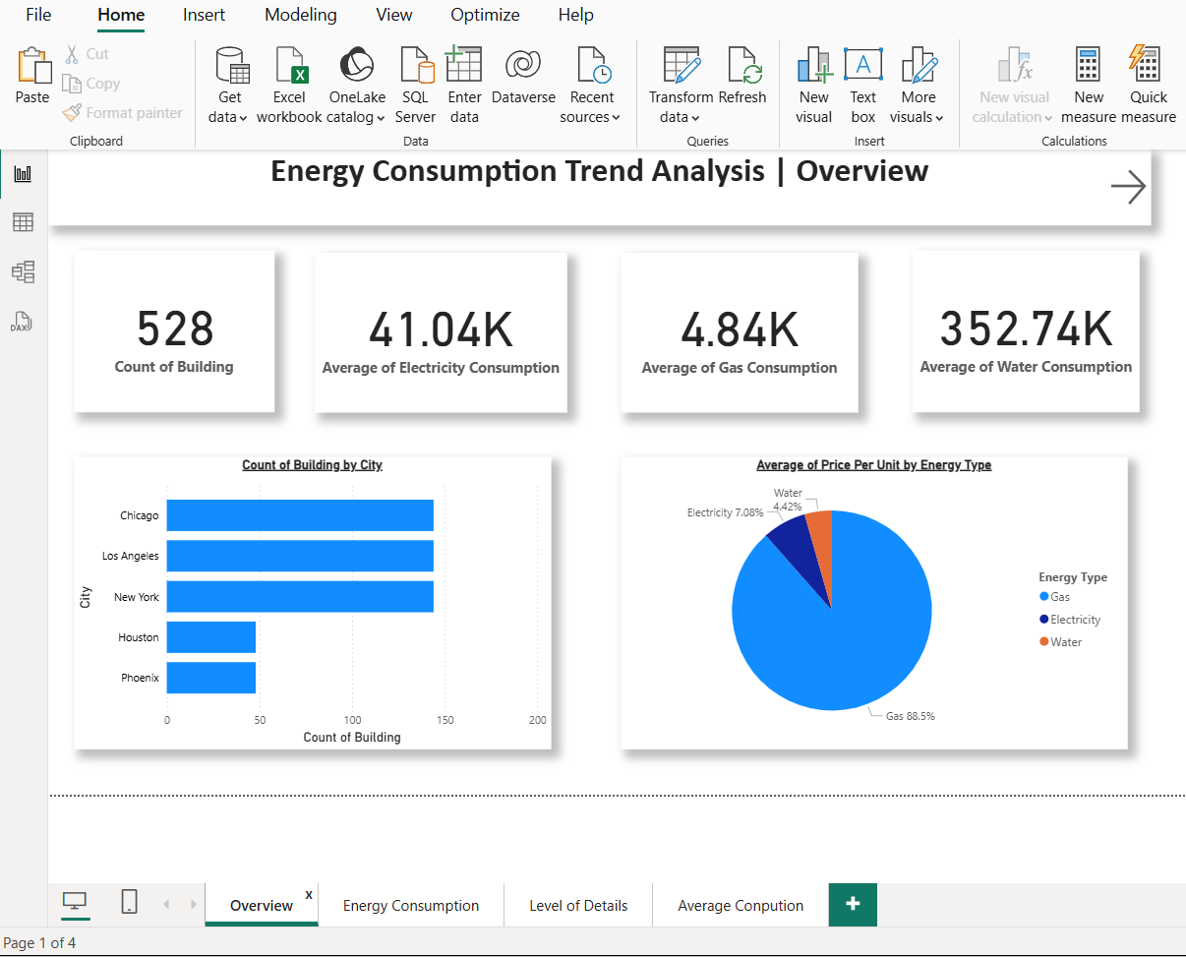
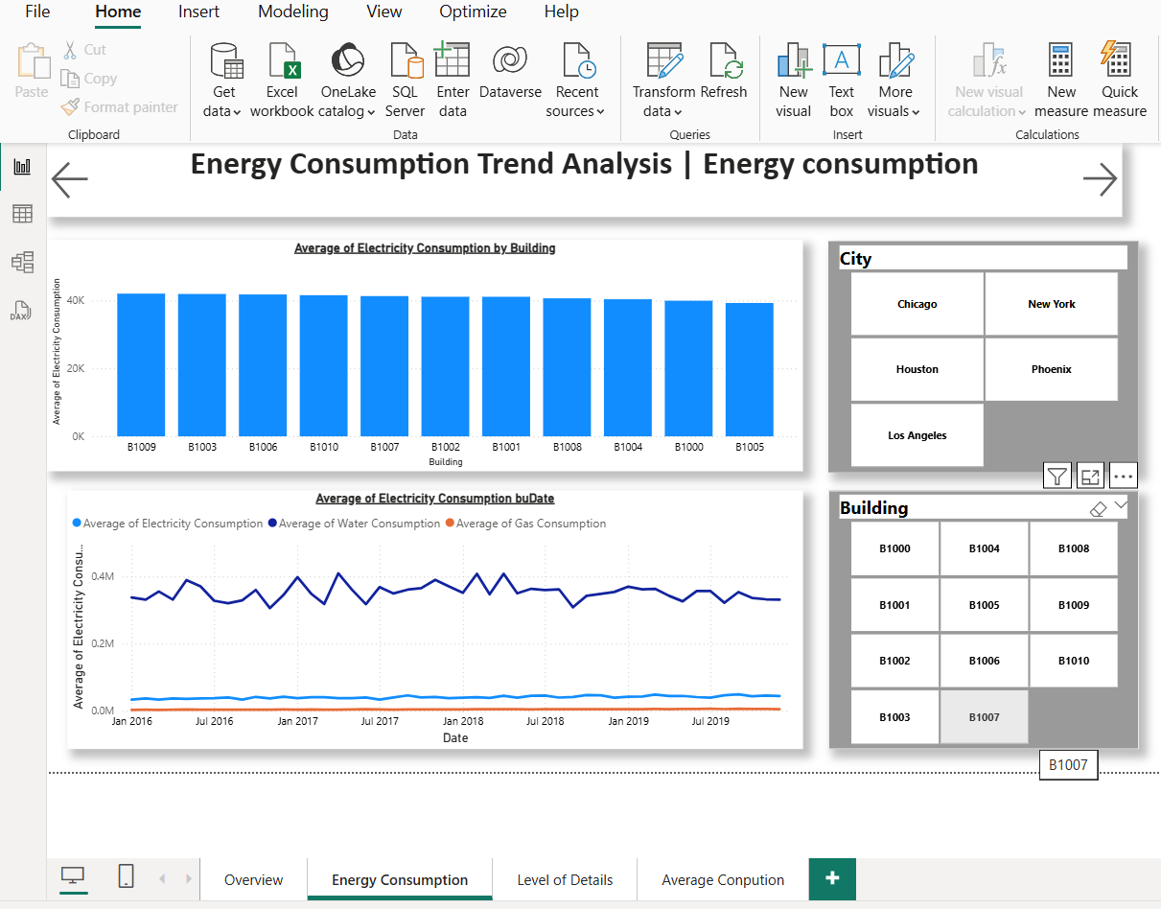
Screenshot of Output:

Slide 10
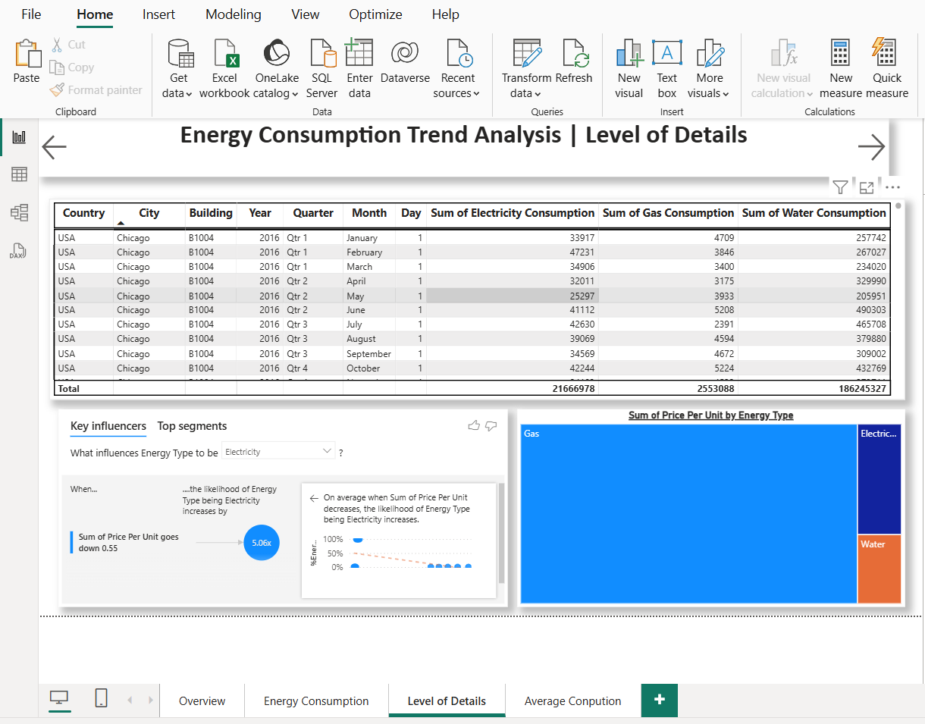
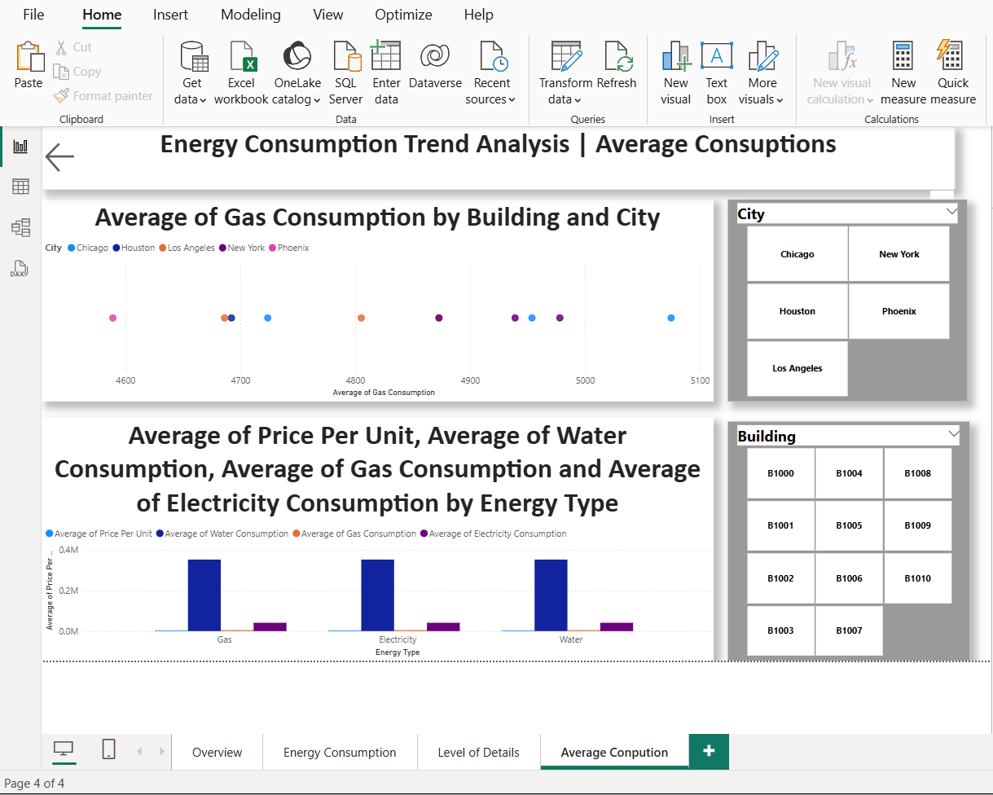

Slide 11
Conclusion:
Energy Consumption Overview:
There are 528 buildings in the dataset.
The average electricity consumption across all buildings is 41.04K.
The average gas consumption is 4.84K.
The average water consumption is 352.74K.
Energy Consumption by City:
The data shows the breakdown of building counts by city, with Chicago having the highest number of buildings, followed by Los Angeles, New York, Houston, and Phoenix.
Energy Types and Pricing:
The chart highlights that Gas contributes the largest portion of energy consumption (88.5%), followed by Electricity (7.08%) and Water (4.42%).
This trend emphasizes that gas is the dominant energy source for the buildings in the dataset.

Slide 12
Level of Detail Insights:
The detailed data includes information on electricity, gas, and water consumption by various factors like city, building, and year.
Key insights from the data suggest that as the sum of the price per unit goes down, the likelihood of energy type being electricity increases.
Energy Consumption Trends:
The analysis also touches on seasonal consumption patterns. For instance, the data includes monthly energy consumption, helping to analyze if there are spikes in certain months.
Key Influencers:
The analysis looks at what factors influence the type of energy used, particularly highlighting electricity as more likely to be used when the price per unit goes down.
From the provided overview and detailed analysis, it's clear that gas consumption is dominant in the dataset. There are patterns related to the pricing of energy sources that influence electricity usage. The data gives valuable insights into energy consumption trends by city and building type, which could be used for making informed decisions about energy management and cost-saving strategies across various buildings and locations.
Git hub repository link: https://github.com/Adhisheshu1210/Energy-Consumption.git

